Slide 1

Data Pipeline for Weather Type Classification Using Kafka and MongoDB
Atharva Khaire
U15258568

Slide 2
Abstract
Building a data pipeline for processing weather data from the Weatherstack API is the primary objective of this project. The pipeline extracts, processes, and stores the data using Kafka, Python, and MongoDB.
The pipeline's initial step is to pull historical and current weather information from the Weatherstack API. To enable effective and scalable processing, this data is subsequently sent into city-wise Kafka topics.
The data is taken from the Kafka topics and stored in MongoDB as JSON files using a Python script. Large amounts of data can be stored in MongoDB, a scalable NoSQL database.
To extract the city-specific data from MongoDB and process it for weather type categorization using variables like temperature, pressure, and humidity, another Python script is needed. After that, MongoDB creates a new collection out of the generated data.
The processing of meteorological data may be done in real time using Kafka, and it can be stored and retrieved effectively and flexibly using MongoDB. A wide range of applications, including agriculture, transportation, and emergency management, can make use of the weather type classification, which offers insightful information about the weather in each city.

Slide 3
Key Elements of the Pipeline
Apache Kafka - An excellent option for creating real-time data pipelines and streaming applications is Apache Kafka, a distributed streaming platform that enables you to publish and subscribe to streams of records.
Zookeeper - Distributed coordination services like Zookeeper are frequently used to manage configuration data, naming services, and synchronization amongst distributed systems.
WeatherStack API - WeatherStack API is a well-known RESTful API that offers real-time meteorological information and forecasts for any location in the world, as well as historical weather data, air quality data, and more.
MongoDB - MongoDB is a document-oriented NoSQL database that uses the BSON format, which is similar to JSON, to enable flexible and scalable data storage and retrieval.

Slide 4
Apache Kafka
Topics
A topic is a term for a category or feed under which the producers publish messages. In essence, it is a name that designates a data stream. Typically, topics are arranged according to their subject matter and can have several partitions.
Partitions
A partition is a topic's linearly arranged collection of messages. Each partition consists of an ordered, immutable sequence of records that may be distributedly added to and read. Kafka may share the workload of processing data across several brokers by partitioning a topic.
Brokers
A Kafka server that takes messages from producers, gives them offsets, and then stores them on disk is known as a broker. Each broker is in charge of duplicating data across many brokers for fault tolerance and can manage multiple partitions.
Producers
Producers are programs that disseminate data to Kafka topics. They can direct messages to a particular partition or leave it up to Kafka to select one using a partitioning strategy. Additionally, producers can define a key for each message that will be used to identify the partition to which it will be written.

Slide 5
Consumers
Programs that subscribe to Kafka topics and read data from them are called consumers. They have the ability to read data from one or more topics' partitions and use it immediately. Additionally, consumers have control over the offset of the data they use and can decide to read from a particular offset.
Offset
Each message in a partition is given an offset, which serves as a special identification number. It is used to monitor user progress and make sure that each user only reads a certain amount of the data. Kafka controls the offset, which is controllable by the users.
Replication
Data is duplicated across several brokers during replication to ensure fault tolerance. With one broker acting as the leader and the others as followers, each partition in a subject can be reproduced over many brokers. The leader is in charge of responding to read and write requests, and the followers copy the leader's data.

Slide 6
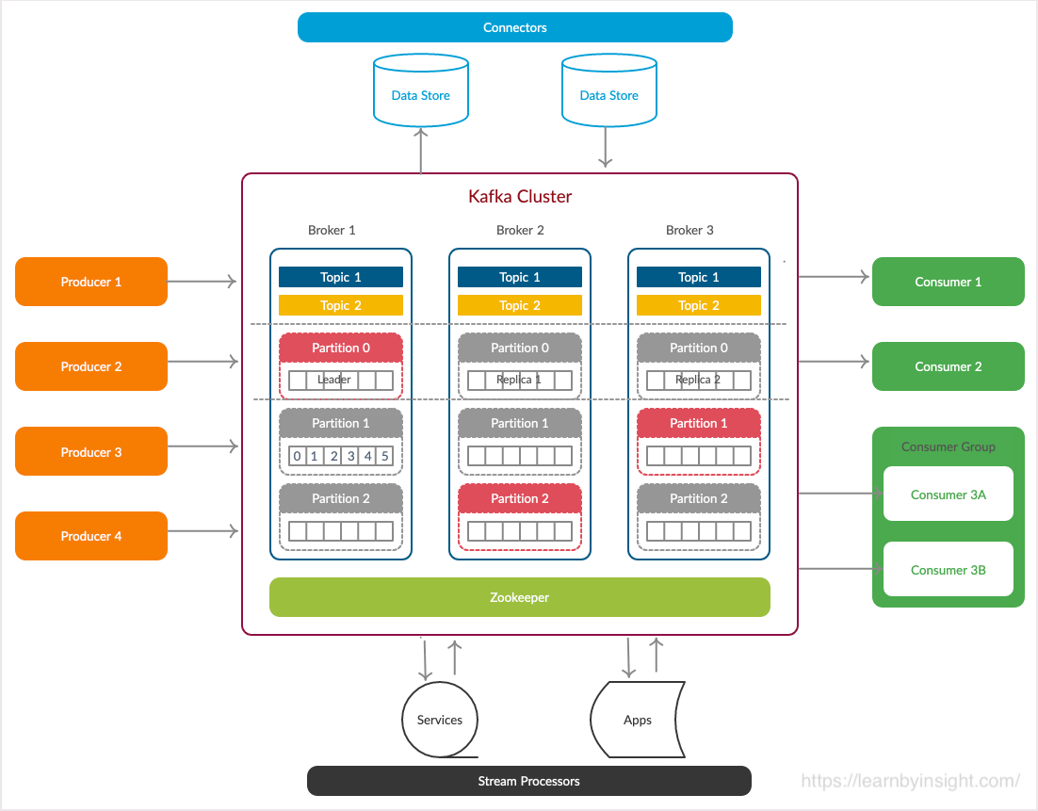

Slide 7
Zookeeper
Znodes
The core units of ZooKeeper are called znodes. They can be used to store data and maintain information and are similar to files or directories in a file system.
ZooKeeper employs znodes in Apache Kafka to store configuration data like the location of brokers and the status of partitions.
Quorum
A quorum is the minimal quantity of ZooKeeper servers required for the system to be operational.
For proper data replication and failover in the event of broker failure in Apache Kafka, a quorum of ZooKeeper servers is necessary.
Leader Election
In the event that the present leader is unsuccessful, a new leader will be chosen through a leader election procedure.
For partitions in a topic, Apache Kafka uses ZooKeeper to manage leader election.
Broker Registration
In order for other brokers and clients to locate a new broker when it is introduced to a Kafka cluster, the broker must register with ZooKeeper. Making a znode in ZooKeeper that contains the broker's metadata, including its ID and network address, is a step in the broker registration process.
Configuration Management
The topic configuration, partition assignment, and broker metadata are only a few of the configuration details that are stored and managed by ZooKeeper in Kafka.
ZooKeeper is used by Kafka brokers and clients to read and write this configuration data, and watches are used to monitor configuration changes.

Slide 8
WeatherStack API
API Key
We need to obtain an API key in order to use the WeatherStack API. This key, which serves as a special identification, is used to verify our queries to the API.
Endpoints
Several endpoints of the WeatherStack API are available for retrieving various kinds of weather data. We can, for instance, use the "current" endpoint to get the weather at a certain area right now or the ”historical” endpoint to get a historical data for a specified amount of time.
Parameters
We can send a number of arguments to the WeatherStack API in order to tailor our query. We can designate the language in which the response should be given or the units in which temperatures should be displayed, for instance. Using arguments like "query" (for a city, zip code, or other location-specific identifier) or "lat" and "lon" (for latitude and longitude coordinates), we can additionally define the place for which we want to get weather data.
Response Format
The JSON format, which is typical for web APIs, is the format in which the WeatherStack API returns data. A number of fields in the response include data about the weather, including fields for temperature, humidity, and wind speed.

Slide 9
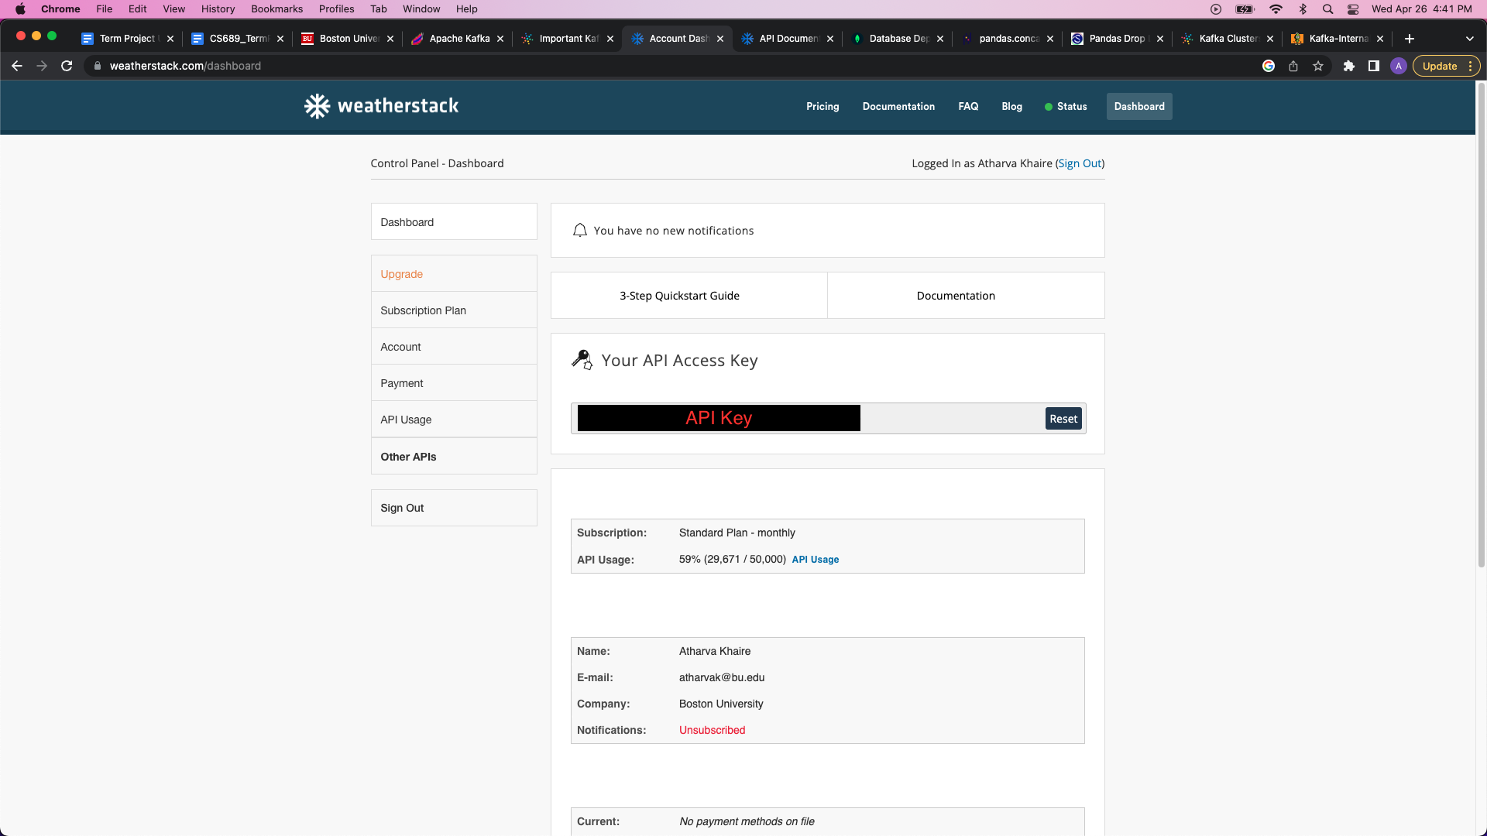
WeatherStack Dashboard

Slide 10
MongoDB
Document-Oriented
As a document-oriented database, MongoDB stores data in the flexible and schema-free BSON (Binary JSON) format. More dynamic schemas can be created than with conventional relational databases thanks to this.
Flexible Data Model
Nested and hierarchical data structures are supported by MongoDB's flexible data model, making it simple to store and retrieve complicated data. As a result, it excels at both storing and retrieving unstructured or semi-structured data, like JSON or XML documents.
Map-Reduce
Map-reduce is supported by MongoDB, allowing for the batch processing of big datasets. Applications involving data analysis and data mining may benefit from this.
Cross-Platform Compatibility
MongoDB is a popular choice for developing web and mobile applications since it works with a wide variety of programming languages and platforms. Additionally, it offers official drivers for well-known programming languages including Java, Python, and Node.js.

Slide 11
Pipeline Construction and Workflow
Launching three separate terminals. One for zookeeper initialization, one for Kafka Broker registration and the last one for Kafka Producer/Consumer operations.
The last terminal is not really needed. I just added it to view events, topics and messages manually for quick access instead of running the python code.
Creating necessary topics and allotting partitions.
Creating and running a python script that extracts 5 years historical data for 10 cities from WeatherStack API and sends it to the corresponding Kafka Topic as a message.
Deploying MongoDB Atlas cluster and connecting this with the Compass cluster.
Creating similar collections as Kafka Topics.
Creating a python script that runs 24/7 extracting 15 min separated real time data for all the cities and pushing it to the corresponding Kafka Topic. This script runs in parallel to all the other scripts.
Creating a python script that loads all the historical data in MongoDB Collections.
Creating a python script that extracts both historical and current weather data and classifies the most recent data entry into a weather type class i.e., Cloudy, Rainy, Snowing etc.

Slide 12
Building the Kafka Environment (Terminals)
Terminal 1: Zookeeper Initialization
Terminal 2: Broker Registration
Terminal 3: Producer/Consumer

Slide 13
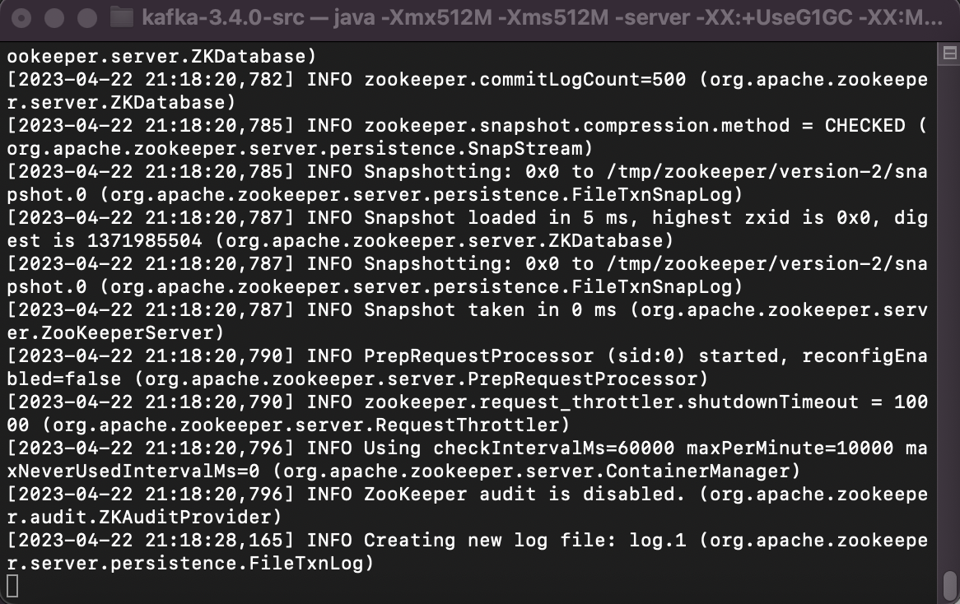
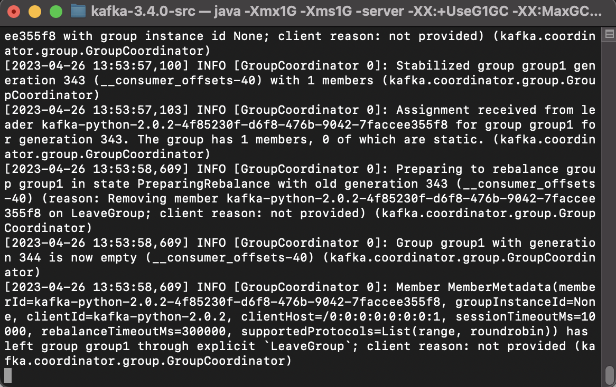
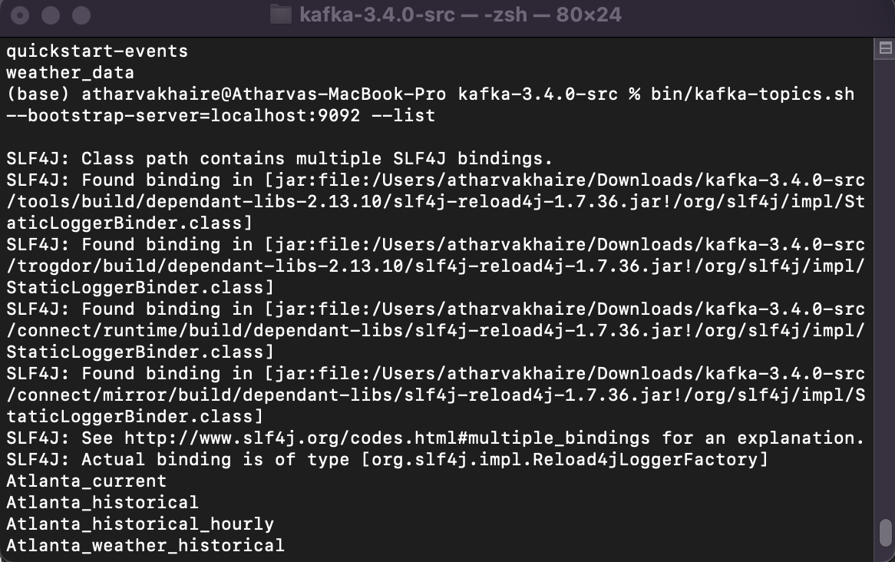
Zookeeper Initialization
Broker Registration
Producer/Consumer

Slide 14
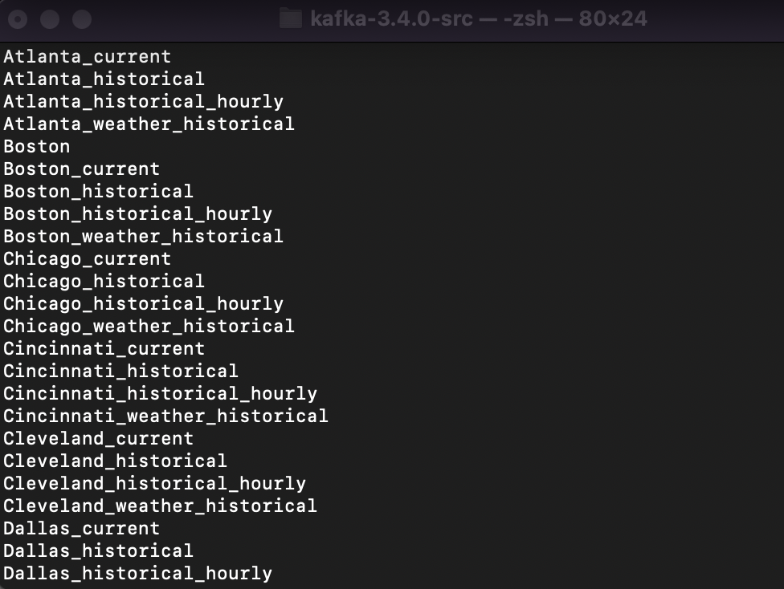
Topic Creation
Topics include:
Atlanta_historical
Boston_historical
Chicago_historical
Cincinnati_historical
Dallas_historical

Slide 15
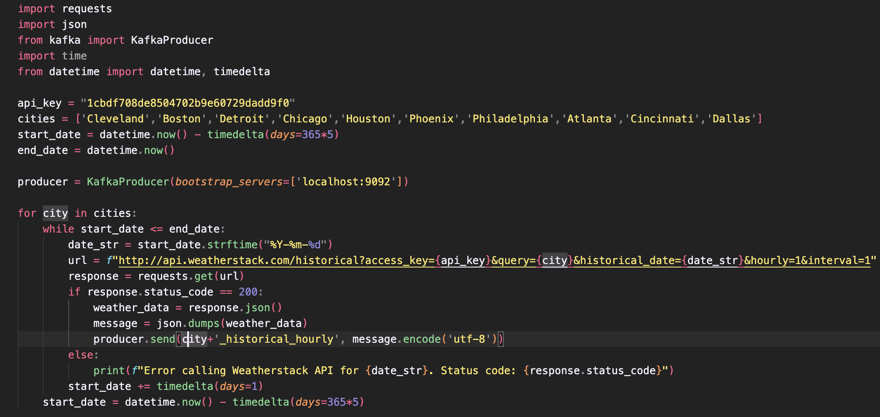
Python Script for Historical Weather extraction

Slide 16
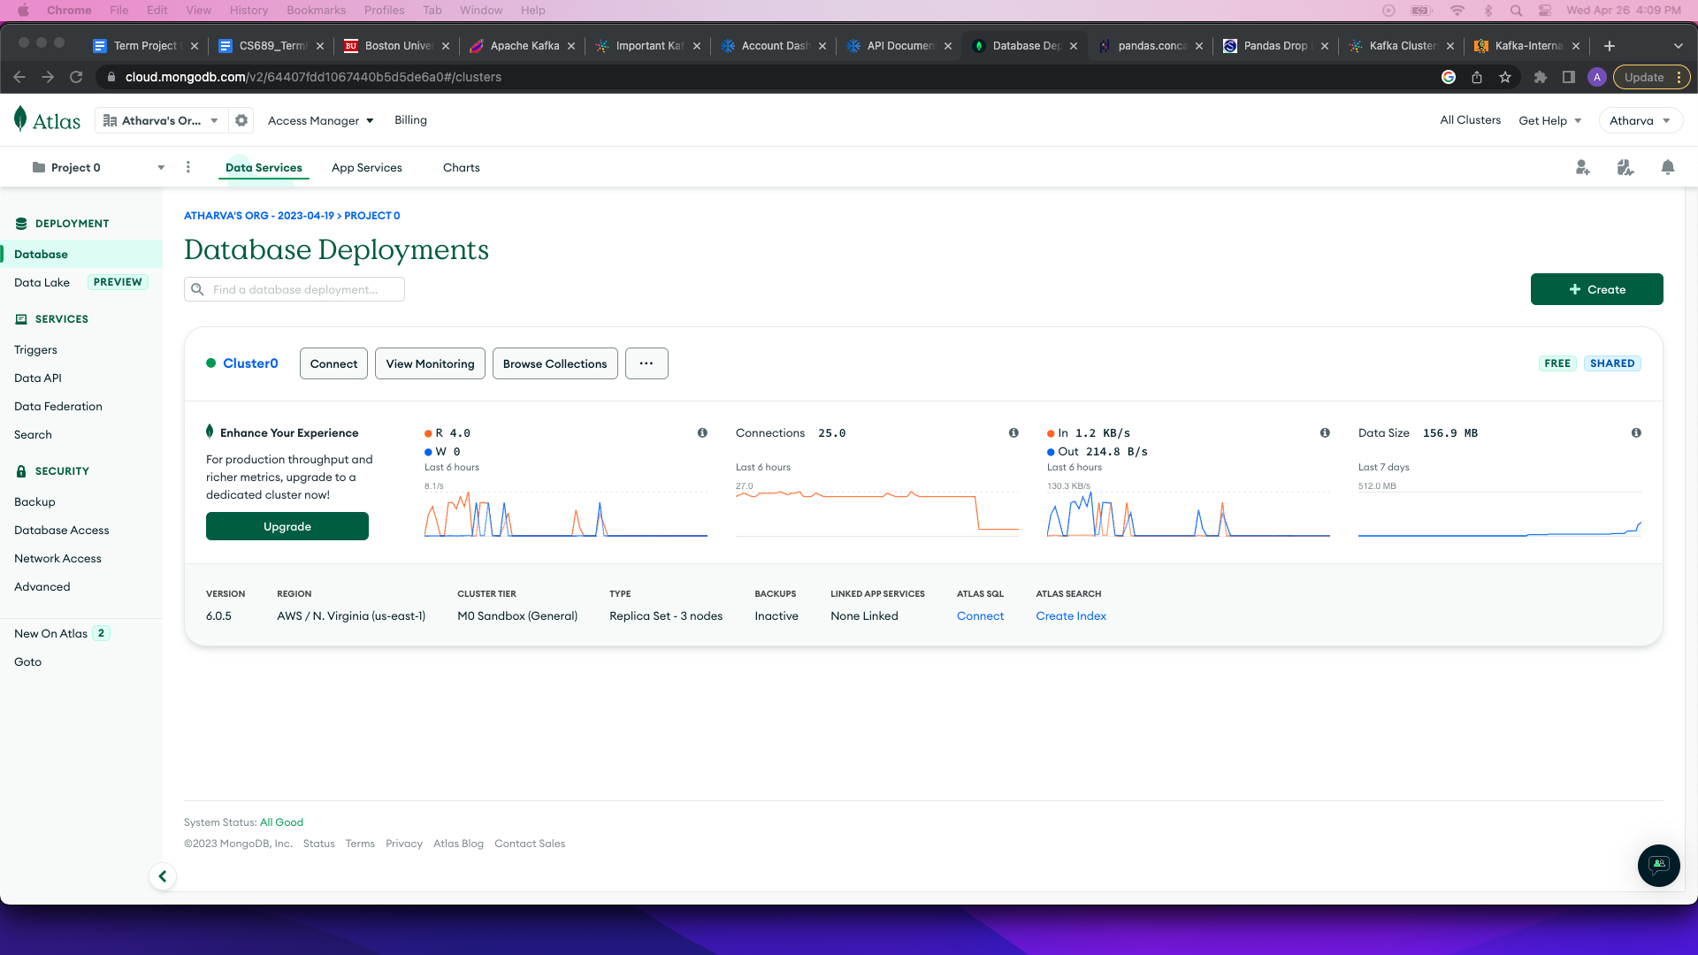
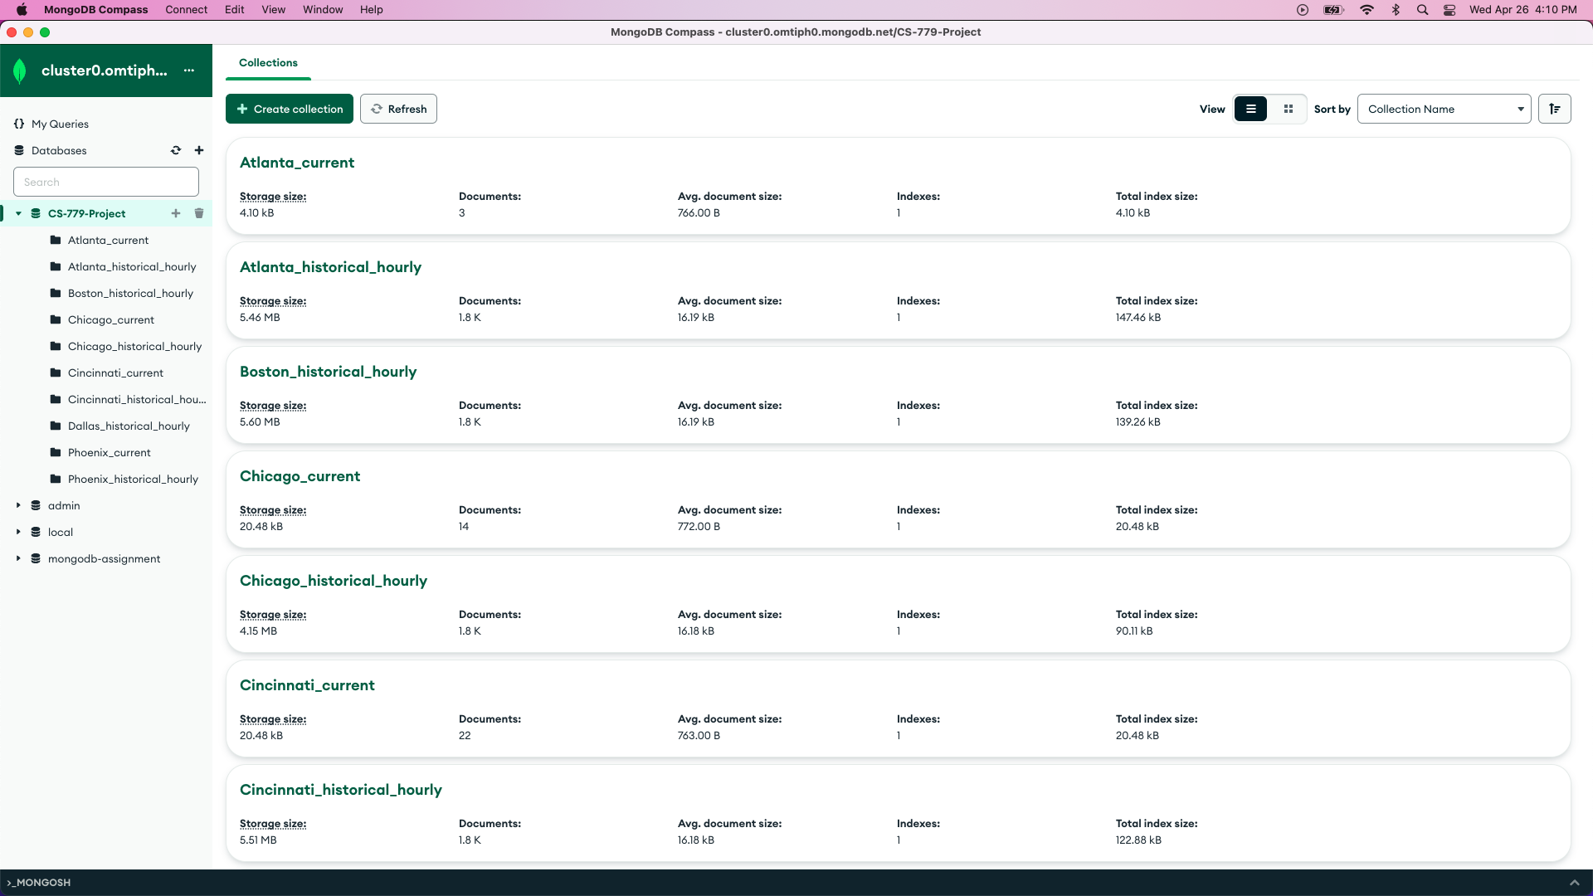
Deployment of MongoDB Atlas and Compass Clusters

Slide 17
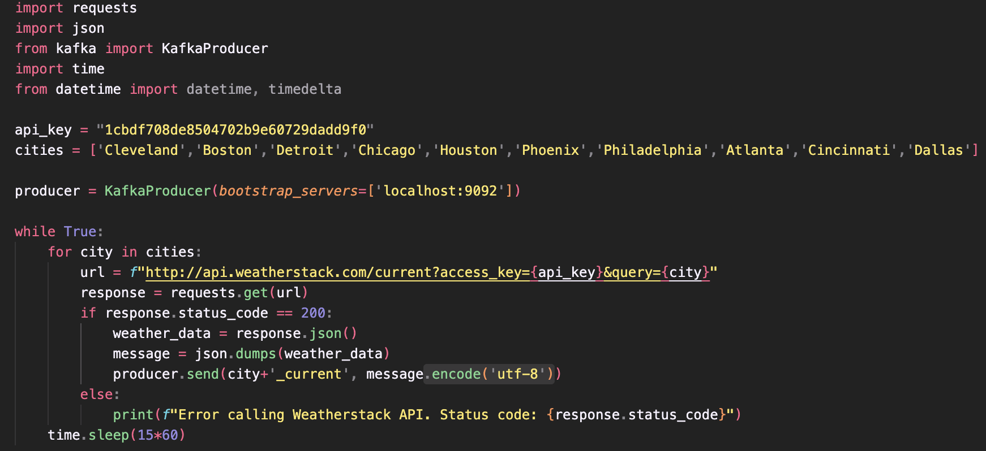
Python Script for Real-Time Weather Data Extraction

Slide 18
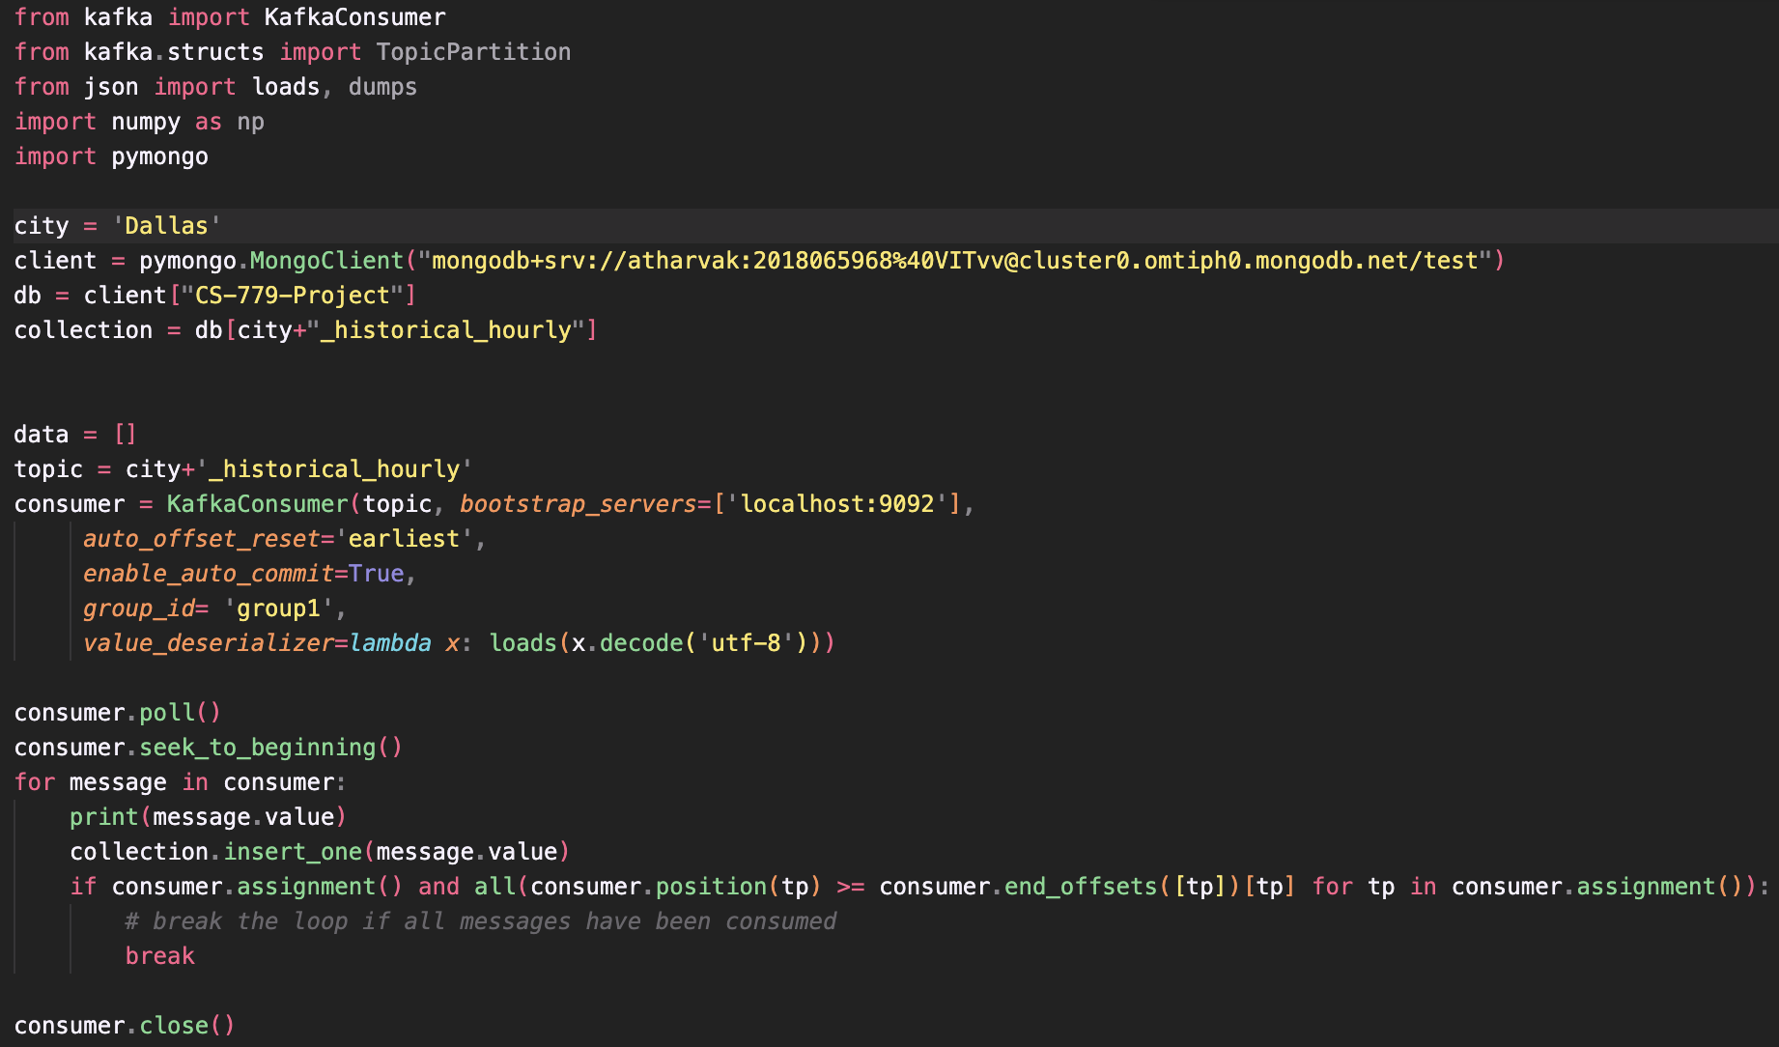
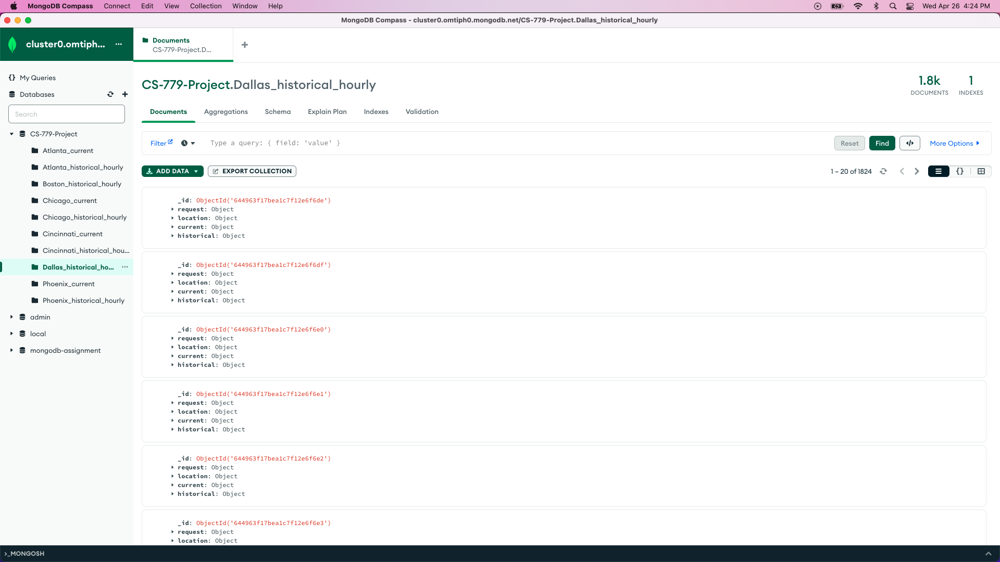
Python Script to load the MongoDB Collections

Slide 19
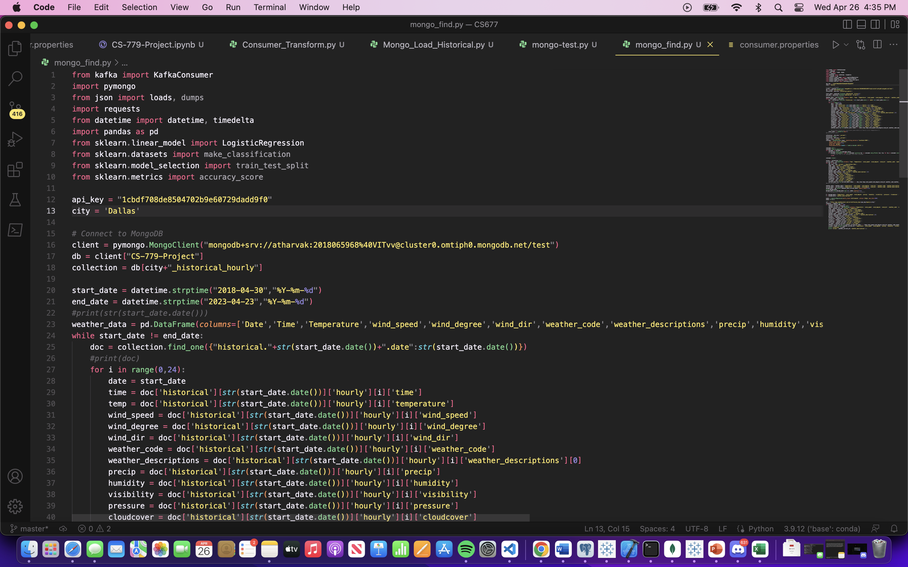
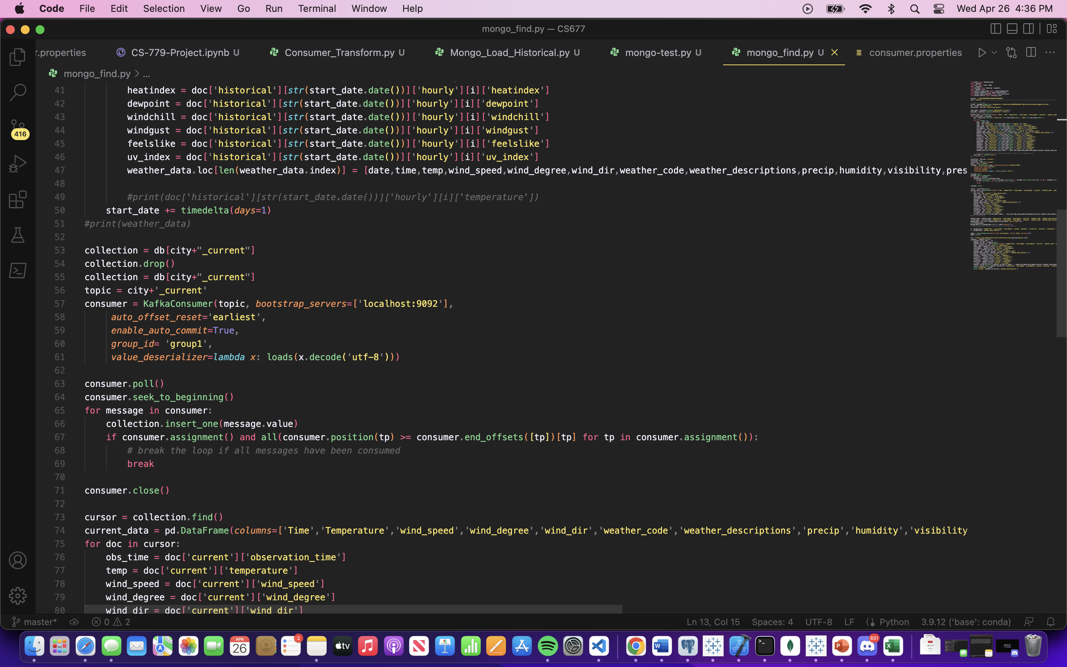
Main Python Script to extract historical and current data and perform classification of Weather Type

Slide 20
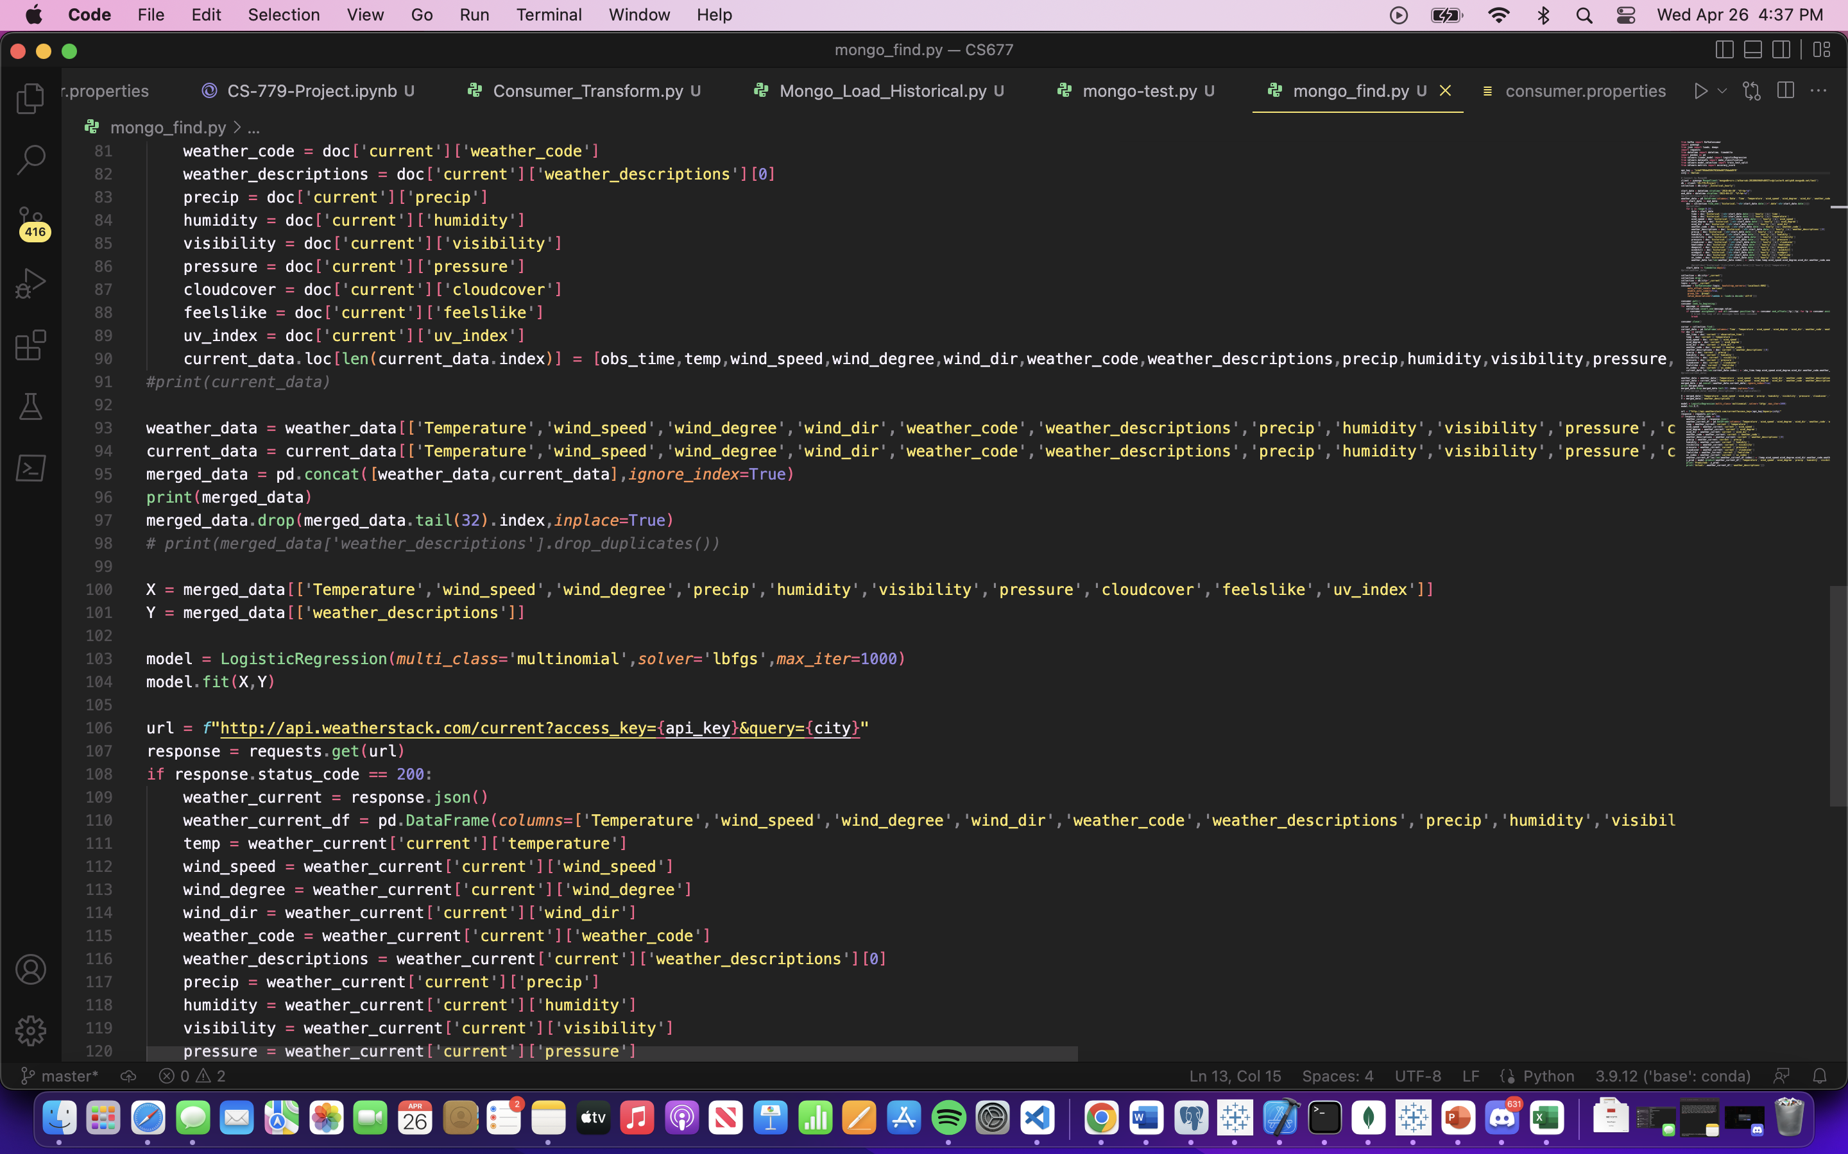

Slide 21
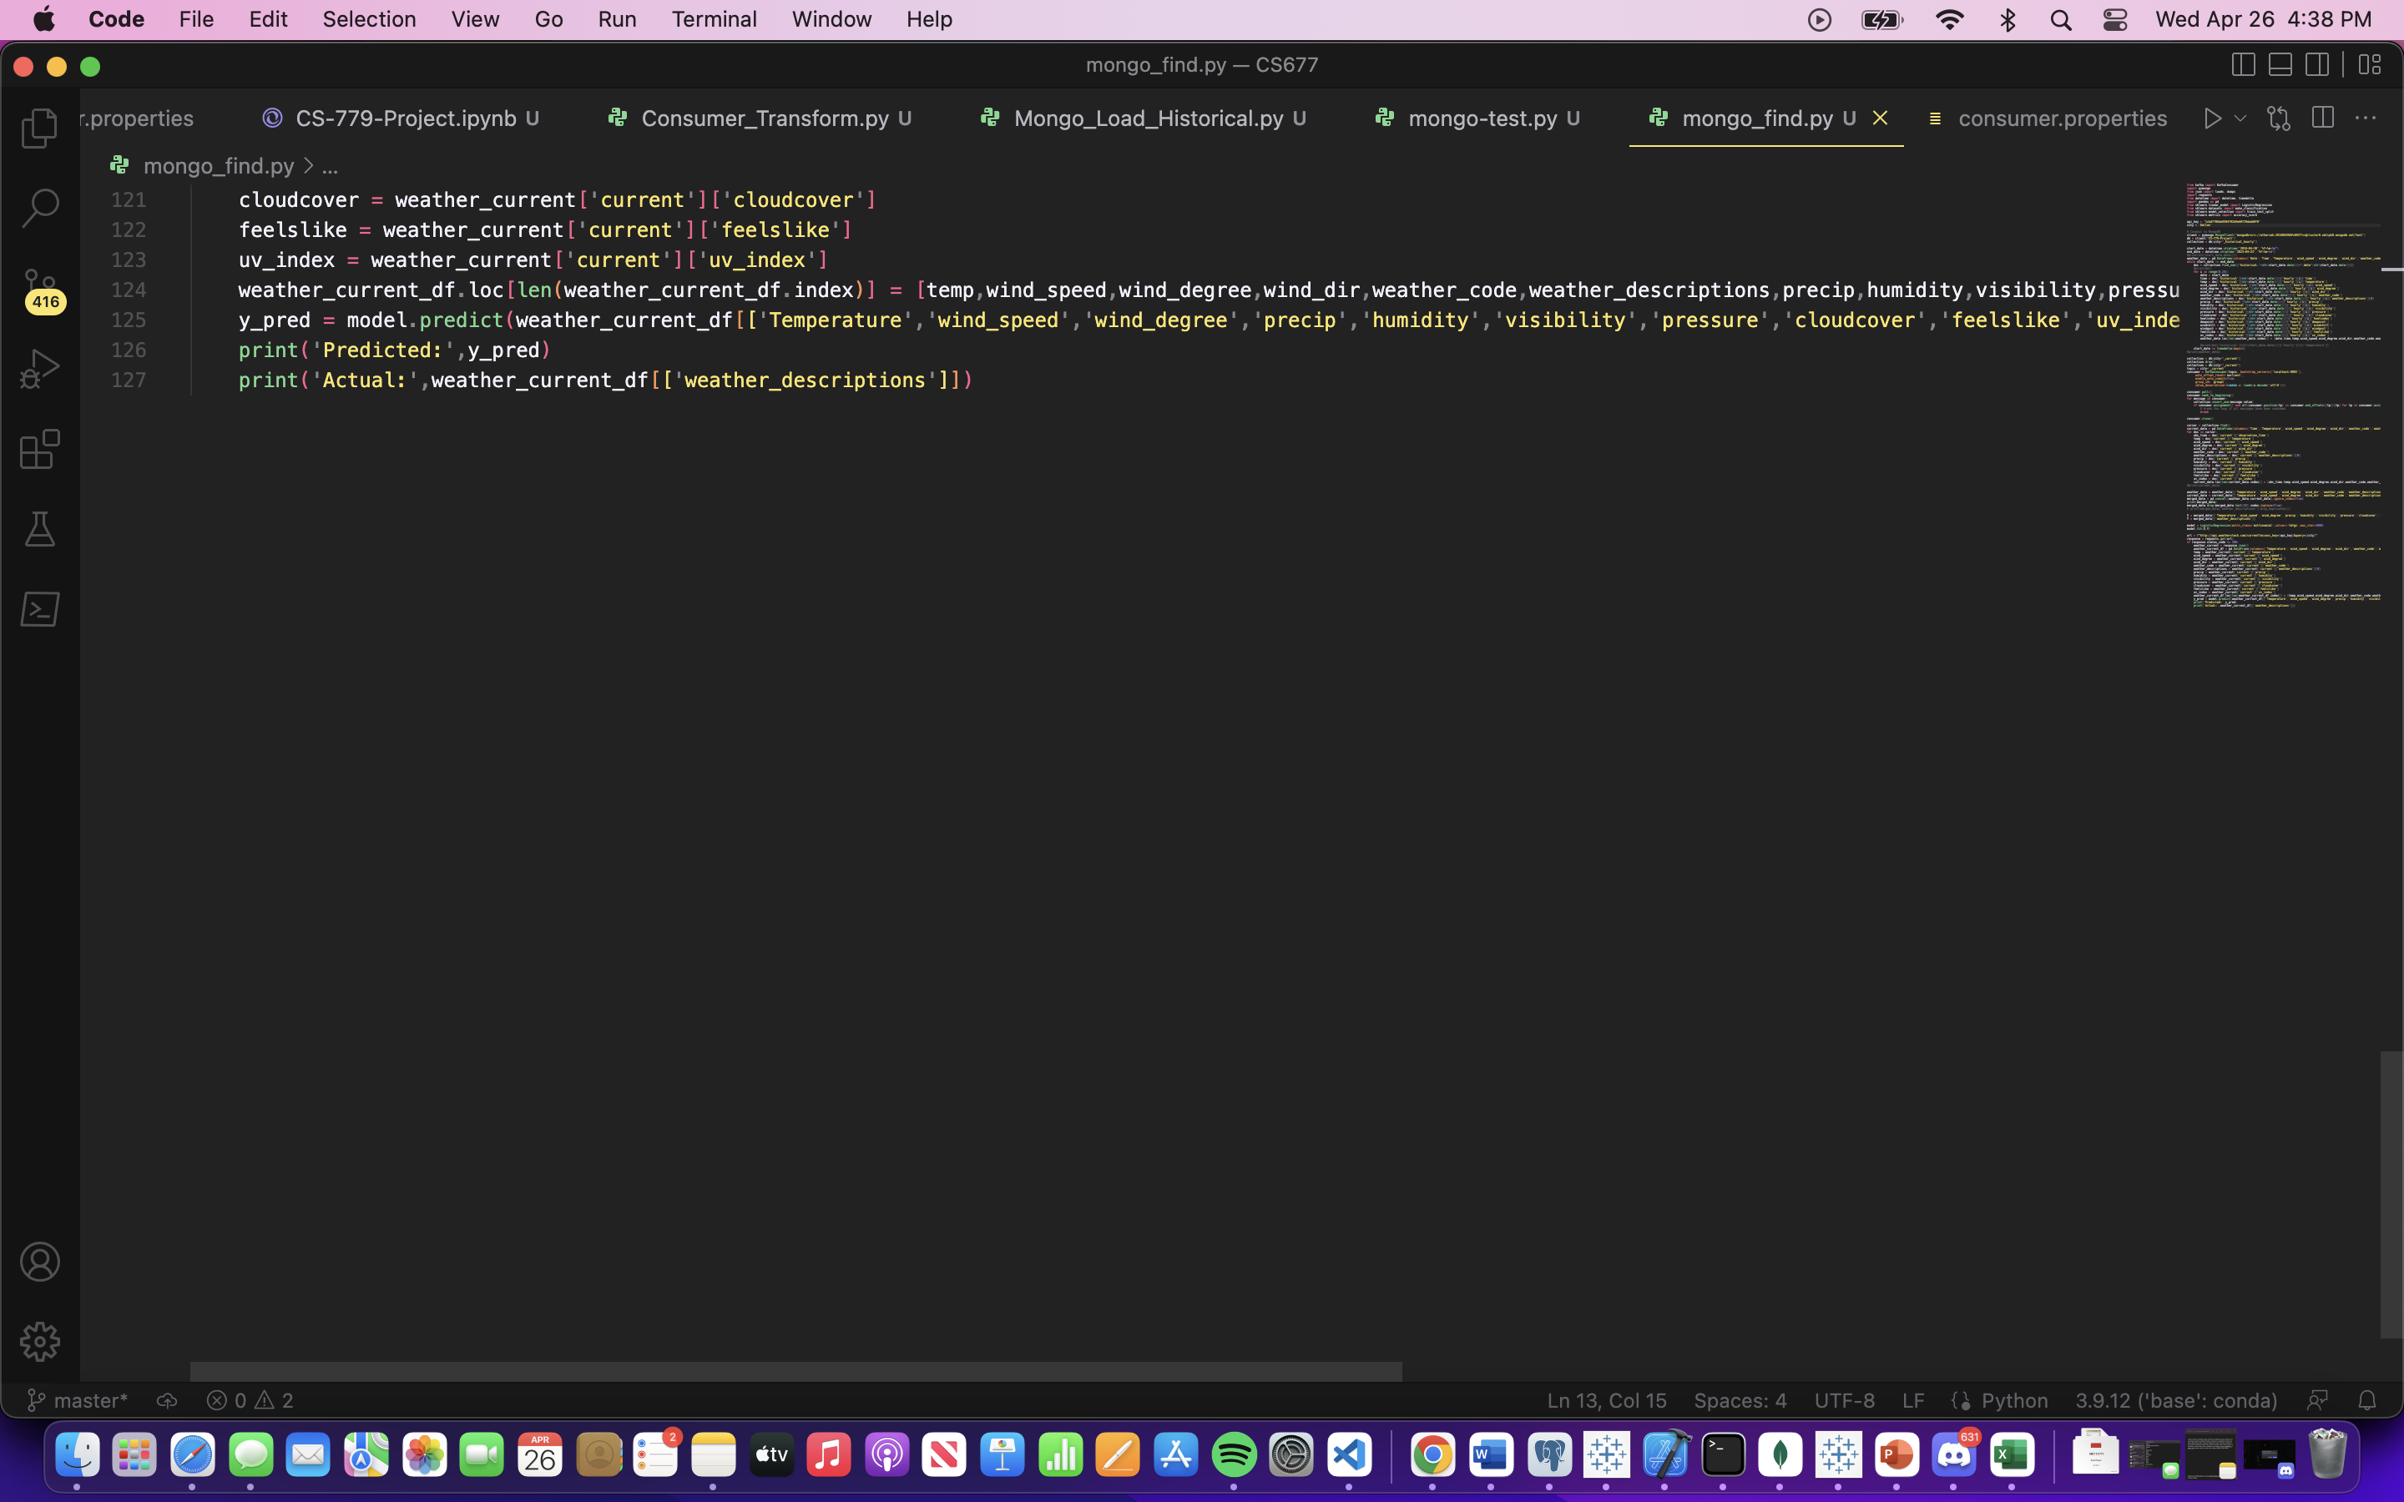

Slide 22
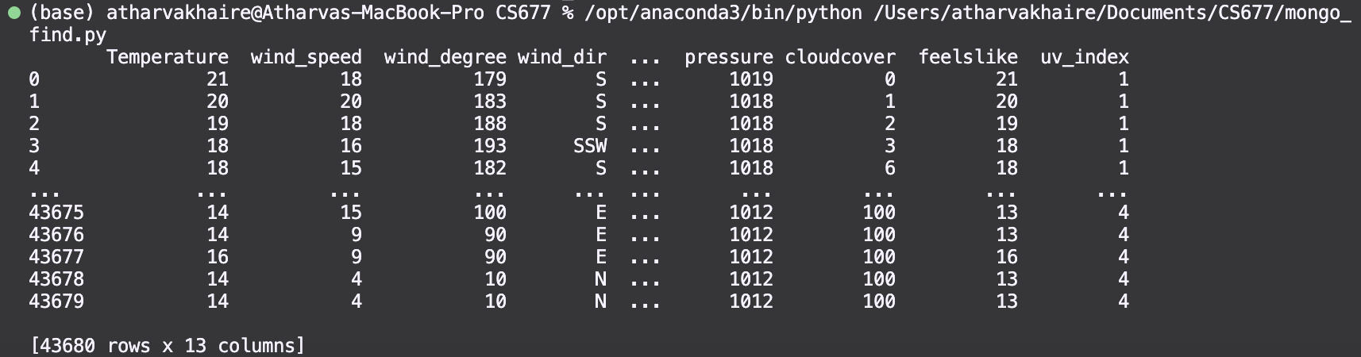
Final Result (Cumulative DataFrame)

Slide 23
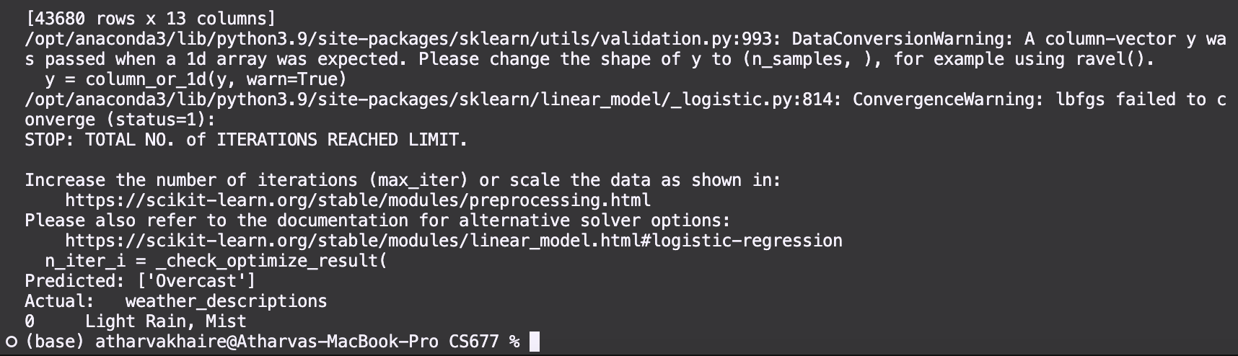
Final Result (Classification)

Slide 24
Thank You!!

